Slide 1

Computational Economics
Module 10. Introduction to Machine Learning

Slide 2
Outline
Introduction to machine learning
The scope of machine learning
To explain or to predict
Hands-on, project-based learning
Supervised learning
classification
regression
Unsupervised learning
cluster analysis

Slide 3
Scope
Artificial Intelligence
ARTIFICIAL INTELLIGENCE
Programs with the ability to reason like humans
Machine Learning
Algorithms with the ability to learn (from data) without being explicitly programmed
Deep Learning
Generative AI

Slide 4
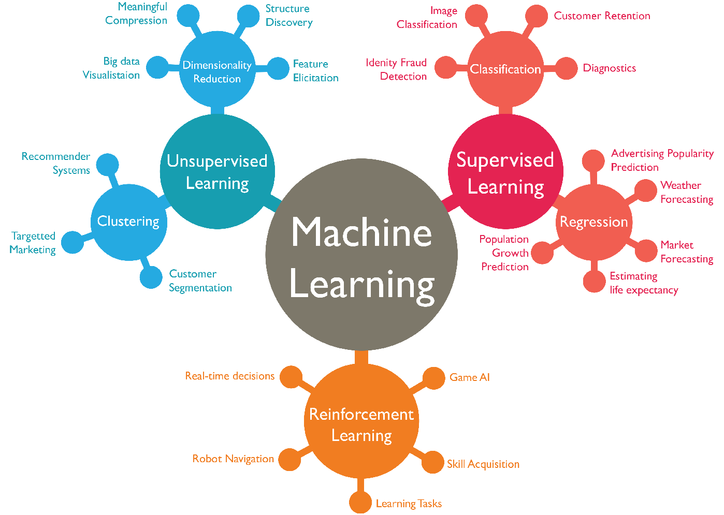
Different Types of
Machine Learning Algorithms

Slide 5
The Language of
Econometrics and Machine Learning
Econometrics | Machine Learning
Data/Observations
Dependent variable
Independent variable
Estimation
Least squares

Slide 6
The Language of
Machine Learning and Econometrics
Econometrics | Machine Learning
Data/Observations | Data/Observations
Dependent variable | Label
Independent variable | Features
Estimation | Model Training
Least squares | Loss function

Slide 7
The Major Differences
Econometrics | Machine Learning
Causality Inference | Association
Theory driven | Data driven
Retrospective | Prospective
bias minimization | good prediction
Research question
Framework
Direction
Priority

Slide 8
To explain or to predict,
that is the question

Slide 9
To explain or to predict
Explaining and Predicting: one or distinct ?
Explaining: aim at knowing and understanding
Source of uncertainty: the truth
Predicting: aim at inferring unknown values from known values
Source of uncertainty: the “yet happened”
Notes:
Example:
Explain: Education – income; minimum wage – unemployment; certain policy – inflation
Predict: predict education, predict unemployment, predict inflation

Slide 10
To explain or to predict
Some extreme views:
“predictive modeling is often valued for its applied utility yet is discarded for scientific purposes such as theory building or testing.”
“In the social sciences, one either did causal modeling econometric style or largely gave up quantitative work”
NOT TRUE
“A low R-squared value is an indicator of low-quality research”
“Models cannot be used for prediction is not worth interpreting”
Notes:
My example:
If good-looking explain wage gap, r^2=0.3
If religious belief explain health condition R^2 = 0.05

Slide 11
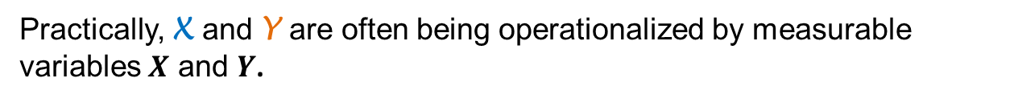

To explain or to predict
Consider a theory postulating that X cause Y ,via the function F, such that
Y = F (X)
Practically, X and Y are often being operationalized by measurable variables $X$ and $Y$.
F is o being operationalized by a statistical model $f$, such that
$$E\left(Y\right)= f(X)$$
Notes:
Example:
If age of a house have any impact on house pricing

Slide 12
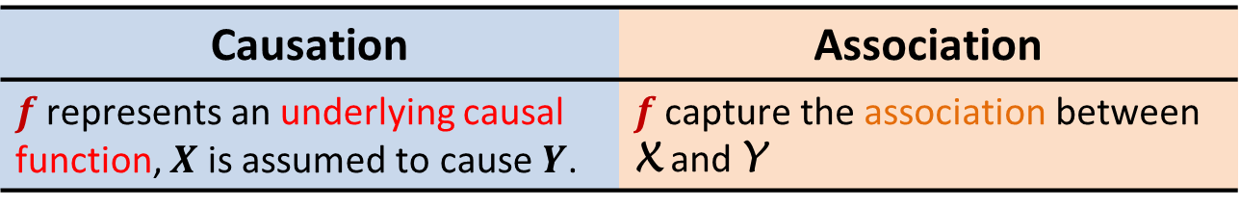
To explain or to predict
Explain | Predict
Causation | Association
$f$ represents an underlying causal function, $X$ is assumed to cause $Y$. | $f$ capture the association between X and Y

Slide 13
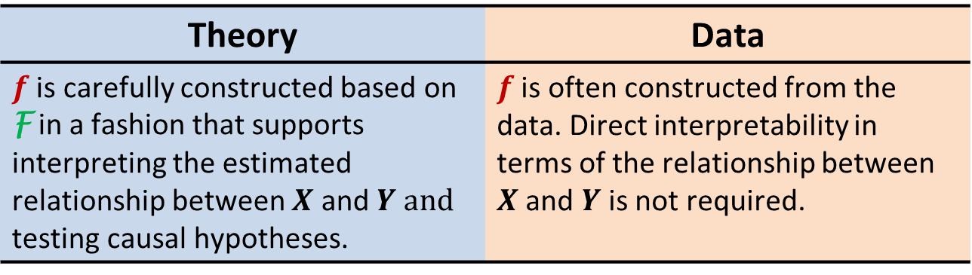
To explain or to predict
Explain | Predict
Theory | Data
$f$ is carefully constructed based on F in a fashion that supports interpreting the estimated relationship between $X$ and $Y and$ testing causal hypotheses. | $f$ is often constructed from the data. Direct interpretability in terms of the relationship between $X$ and $Y$ is not required.
Notes:
Example:
Explain: Start from literature review
e.g. mincers earning function: lnw = f(s, x) = b0 + b1s + b2x + b3x^2 + e
Predict:
No need for theory. However, domain knowledge can make predictive modeling more effective in that you know what variables are important

Slide 14
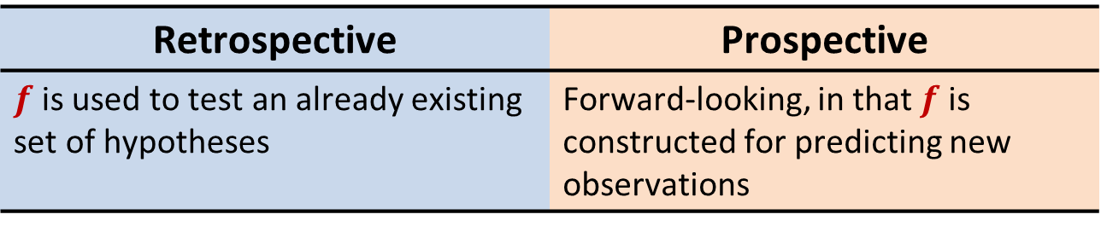
To explain or to predict
Explain | Predict
Retrospective | Prospective
$f$is used to test an already existing set of hypotheses | Forward-looking, in that $f$ is constructed for predicting new observations
Notes:
Explain:
Explain causation based on what have happened
Predict:
Predict the yet-happened.

Slide 15
To explain or to predict
Explain | Predict
Bias minimization | Good prediction
Focus on minimizing bias to obtain the most accurate representation of the underlying theory. i.e., having an unbiased estimator is important. | minimize the combination of bias and estimation variance to obtain the most accurate prediction. i.e., it even sacrifice theoretical accuracy for improved empirical precision.
Notes:
1. Two kinds of bias
Explanatory model: bhat
Predictive model: yhat
The tradeoff between low bias and low variance

Slide 16
To explain or to predict
Explain | Predict
Bias minimization | Good prediction
Focus on minimizing bias to obtain the most accurate representation of the underlying theory. i.e., having an unbiased estimator is important. | minimize the combination of bias and estimation variance to obtain the most accurate prediction. i.e., it even sacrifice theoretical accuracy for improved empirical precision.
Notes:
1. Two kinds of bias
Explanatory model: bhat
Predictive model: yhat
The tradeoff between low bias and low variance

Slide 17
TWO MODELING PATHS

Slide 18
Explanatory modeling:
Identify and Explain causation
Define Goal
Data Collection
EDA
Prepare Data
Select
Variables
Modeling
Result
Predictive modeling:
Make good prediction for unknown data
Notes:
Example:
Online auction research
explanatory: explain what factors determine final price
predictive: use model to predict the final price

Slide 19
Explanatory modeling:
Sample size: depends on necessary statistical power
Sample scheme: diversified sample is preferred
Sample collection: experimental data are greatly preferred
Sample quality: reliable and valid variables are important
Define Goal
Data Collection
EDA
Prepare Data
Select
Variables
Modeling
Result
Predictive modeling:
Sample size: larger sample is always preferred
Sample scheme: more observations in each group is preferred
Sample collection: data better represent the reality are preferred
Sample quality: measurement quality is more important
Notes:
Sample scheme: more groups is better v.s. larger group size is preferred.
10 different types of good on 3 different platforms. Total variable: 20, sample size = 200
One particular good on a specific platforms. Total variable: 6, sample size = 2000
Sample collection: (internal validity) v.s. external validity

Slide 20
Explanatory modeling:
EDA often channeled toward theoretical causal relationship
Explore possible causations
Focus on theoretical relationships
Dimension reduction is used to validate the survey instrument, make the factors more interpretable.
Define Goal
Data Collection
EDA
Prepare Data
Select
Variables
Modeling
Result
Predictive modeling:
Exploratory Data Analysis is conducted in a more free-form fashion
Explore a wide and sometimes unknown terrain
No theoretical guide for numerical summary
Dimension reduction is used as a tool to reduce sampling variance, use compressed (yet less interpretable) variables as predictor.
Notes:
Example: different use of PCA
Explanatory: better understand the instrument, and make the fatcors ore interpretable
e.g., good rating, bad rating-→ reputation matters
SVD (singular value decomposition)

Slide 21
Explanatory modeling:
Data partitioning:
Very rare. All-data-together is the most common practice
Handling missing values
Drop observations with missing values
Drop columns with missing values
Imputation
Define Goal
Data Collection
EDA
Prepare Data
Select
Variables
Modeling
Result
Predictive modeling:
Data partitioning: a key step in predictive modeling
train-test; train-test-valid; cross-validation
Handling missing values
The solution strongly depends on the context
Missingness can be a blessing in certain context
Notes:
Imputation algorithms: mean, conditional mean, regressions, dummy variables
Missing value as blessing: product detailed description is missing

Slide 22
Explanatory modeling:
Select variables based on the role in the causal structure:
moderator, mediator, treatment, etc. use variables (or even create variables) to overcome endogeneity
check for multicollinearity
Define Goal
Data Collection
EDA
Prepare Data
Select
Variables
Modeling
Result
Predictive modeling:
Select variables based on the data itself:
quality of the association between the predictors and the response
data quality
availability of the predictor
Notes:
One particular variable:
Total numbers of bid
being excluded from the explanatory model because of endogeneity

Slide 23
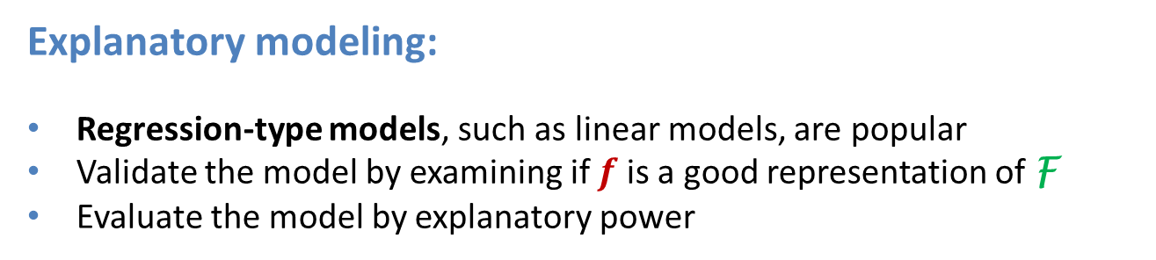
Explanatory modeling:
Regression-type models, such as linear models, are popular
Validate the model by examining if $f$ is a good representation of F
Evaluate the model by explanatory power
Define Goal
Data Collection
EDA
Prepare Data
Select
Variables
Modeling
Result
Predictive modeling:
Algorithmic-type models, such as tree-based models, are popular
Validate the model by examining its generalizability
Evaluate the model by predictive power:
e.g., accuracy, precision, recall, R² ,etc.
Notes:
Regression (good interpretability)
if it capture the causality, statistical significance for the parameter
compare linear and algorithmic type models
Algorithmic (good prediction)
validate by generalizability, overfitting. Explain overfitting
bias-variance trade-off

Slide 24
Explanatory modeling:
Make scientific conclusions regarding F, X, Y and the causal hypotheses
Mostly statistical inference + theoretical explanation
Results from several models are often presented side-by-side to compare their explanatory power
Define Goal
Data Collection
EDA
Prepare Data
Select
Variables
Modeling
Result
Predictive modeling:
Make predictions
Predictive power and its comparison across models being the core
Notes:
Regression result table

Slide 25
Hands-on learning
In this project, we will use a real estate dataset to build machine learning models step-by-step.

Slide 26
Exploratory Data Analysis (EDA)
Machine Learning for Predictive Modeling (1)

Slide 27
Data Partitioning
Notes:
Nov 17. Machine learning: Prepare the Data
Data Partitioning
Handling missing values (imputation)

Slide 28
Split the Dataset (train)
All Data (train)

Slide 29
Split the Dataset (train)
All Data (train)
Training Set
Testing Set

Slide 30
Split the Dataset (train)
All Data (train)
Training Set
Testing Set
Training Set
Validation
Testing Set

Slide 31
Handling Missing Data: imputation
Replacing missing data with substituted values

Slide 32

Imputation
Benefits (if used properly):
Reduce estimation bias
Improve model’s predictive accuracy
Reduce variance
Risk:
Introduce new bias (yikes~!)
Caveat: To impute or not impute, that is the question

Slide 33
Imputation
Types of missing data (by assumptions)
Replacing missing values with variable statistics, such as mean, median, mode, max, min, etc.
K-Nearest Neighbors
Dummy variable adjustment

Slide 34
Imputation
Types of missing data (by assumptions)
Missing Completely At Random (MCAR):
Missing due to bad luck, record errors, no specific patterns.
Missing At Random (MAR)
There might be systematic differences between the missing and observed values, but these can be explained by other observed variables.
Missing Not At Random (MNAR)
Probability of being missing varies for reasons that are unknown to us.
Notes:
MCAR（完全随机缺失）
例子：在一项调查中，某些问卷因为打印机卡纸而没有打印出来，导致部分被调查者根本没收到问卷。这个缺失和问卷内容、被调查者的特征（收入、健康状况等）完全无关，纯粹是设备故障造成的随机事件。
再比如：实验室仪器偶尔随机死机，导致某些样本的检测数据丢失——丢失与样本本身的性质无关。
MAR（随机缺失，可由已观测变量解释）
例子：在健康调查中，男性比女性更不愿意回答关于"抑郁症状"的问题，导致男性这一变量的缺失率更高。这里缺失不是完全随机的（性别决定了缺失概率），但因为"性别"是我们观测到的变量，一旦控制了性别，缺失与抑郁症状本身的严重程度就不再相关了。
再比如：老年人比年轻人更常跳过"手机使用习惯"这一题——年龄是已观测变量，可以解释缺失模式。
MNAR（非随机缺失，缺失概率与未观测的值本身有关）
例子：在收入调查中，高收入人群更倾向于拒绝透露自己的具体收入数字。这里缺失的原因恰恰是"收入"这个变量本身的取值（越高越可能不填），而这个真实收入值我们并不知道（因为它就是缺失的那部分），所以无法用其他已观测变量完全解释。
再比如：在抑郁症调查中，症状最严重的患者可能因为情绪低落、无力填写问卷而直接退出研究——缺失与"未被观测到的真实抑郁严重程度"直接相关。
一个简单的记忆方式：
类型缺失原因是否可预测关键点MCAR完全不可预测纯随机噪声MAR可由已观测变量预测控制其他变量后缺失变得随机MNAR只能由未观测（缺失本身）的值预测最难处理，需要额外建模假设

Slide 35
Imputation
Method 1: Replacing missing values with variable statistics, such as mean, median, mode, max, min, etc.
Mean or median replacement are the easiest way to handle missing data.
These methods often work well for MCAR.

Slide 36
Imputation
Method 2: K-nearest neighbor
Impute the missing value based on similar observations.
It assumes that the missingness could be explained by other observed variables
This method is ideal for MAR
Notes:
Example, GarageYearBuilt

Slide 37
Imputation
K-nearest neighbor
Index | Overall Quality | Year Built | GarageCars | GarageYrBlt | TotalSF | BedroomAbvGr
0 | 9 | 2011 | 2 | 2011 | 3100 | 4
1 | 6 | 2009 | 2 | ? | 2700 | 4
2 | 10 | 2017 | 3 | 2018 | 4200 | 3
3 | 7 | 2008 | 2 | 2009 | 2800 | 4
4 | 3 | 1989 | 1 | 1990 | 1809 | 3
Notes:
Example, GarageYearBuilt

Slide 38
Imputation
K-nearest neighbor
Index | Overall Quality | Year Built | GarageCars | GarageYrBlt | TotalSF | BedroomAbvGr
0 | 9 | 2011 | 2 | 2011 | 3100 | 4
1 | 6 | 2009 | 2 | ? | 2700 | 4
2 | 10 | 2017 | 3 | 2018 | 4200 | 3
3 | 7 | 2008 | 2 | 2009 | 2800 | 4
4 | 3 | 1989 | 1 | 1990 | 1809 | 3
Step 1. identify the case with missing value you want to fill
Notes:
Example, GarageYearBuilt

Slide 39
Imputation
K-nearest neighbor
Index | Overall Quality | Year Built | GarageCars | TotalSF | BedroomAbvGr
0 | 9 | 2011 | 2 | 3100 | 4
1 | 6 | 2009 | 2 | 2700 | 4
2 | 10 | 2017 | 3 | 4200 | 3
3 | 7 | 2008 | 2 | 2800 | 4
4 | 3 | 1989 | 1 | 1809 | 3
dist=3
dist=4
dist=1
dist=8
Step 2. use available information to calculate the “similarity” between this case and other cases.
Notes:
Example, GarageYearBuilt

Slide 40
Imputation
K-nearest neighbor
Index | Overall Quality | Year Built | GarageCars | TotalSF | BedroomAbvGr
0 | 9 | 2011 | 2 | 3100 | 4
1 | 6 | 2009 | 2 | 2700 | 4
2 | 10 | 2017 | 3 | 4200 | 3
3 | 7 | 2008 | 2 | 2800 | 4
4 | 3 | 1989 | 1 | 1809 | 3
dist=3
dist=4
dist=1
dist=8
Step 3. Determine how many neighbors you want to use, and select the nearest neighbors. For example, n=2
Notes:
Example, GarageYearBuilt

Slide 41
Imputation
K-nearest neighbor
Index | Overall Quality | Year Built | GarageCars | TotalSF | BedroomAbvGr
0 | 9 | 2011 | 2 | 3100 | 4
1 | 6 | 2009 | 2 | 2700 | 4
2 | 10 | 2017 | 3 | 4200 | 3
3 | 7 | 2008 | 2 | 2800 | 4
4 | 3 | 1989 | 1 | 1809 | 3
dist=3
dist=1
Step 3. Determine how many neighbors you want to use, and select the nearest neighbors. For example, n=2
Notes:
Example, GarageYearBuilt

Slide 42
Imputation
K-nearest neighbor
Index | Overall Quality | Year Built | GarageCars | GarageYrBlt | TotalSF | BedroomAbvGr
0 | 9 | 2011 | 2 | 2011 | 3100 | 4
1 | 6 | 2009 | 2 | (2011+ 2009)/2 | 2700 | 4
2 | 10 | 2017 | 3 | 2018 | 4200 | 3
3 | 7 | 2008 | 2 | 2009 | 2800 | 4
4 | 3 | 1989 | 1 | 1990 | 1809 | 3
Step 4. fill the missing value with the mean of the selected neighbors
Notes:
Example, GarageYearBuilt

Slide 43
Imputation
Method 3: Heckman Selection Model
This method is suit for MNAR.

Slide 44

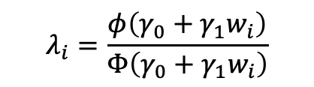
Imputation
Method 3: Heckman Selection Model
Index | Overall GPA (y) | Econ 380 Course evaluation (x) | Economic major (z)
0 | 3.7 | 5.0 | 1
1 | 2.8 | ? | 1
2 | 4.0 | 4.9 | 0
3 | 3.6 | 4.8 | 1
4 | 3.3 | 4.7 | 0
Step 1. Selection Model
Then calculate Inverse Mills Ratio ( IMR ) for each observation
$$λ_{i}=\frac{φ\left(γ_{0}+γ_{1}w_{i}\right)}{Φ\left(γ_{0}+γ_{1}w_{i}\right)}$$
Notes:
先建立一个模型，预测"这个学生是否会填评教"（是否被观测到）：
$$P\left(D_{i}=1\right)=Φ\left(γ_{0}+γ_{1}w_{i}\right)$$
$D_{i}=1$表示评分被观测到（没缺失），$D_{i}=0$表示缺失
用probit模型估计
$w_{i}$是影响"是否填写评教"的变量——关键是需要至少一个只影响"是否填写"、但不直接影响"评分高低"的变量（称为exclusion restriction，排他性约束）。比如："学校是否发了填写提醒邮件"、"该学期是否有填写评教送积分的激励政策"——这些会影响学生是否愿意填，但不太可能直接决定评分打多高。
从这一步，为每个观测计算出一个叫 逆米尔斯比率（Inverse Mills Ratio, IMR, 记作 λ） 的修正项：
$$λ_{i}=\frac{φ\left(γ_{0}+γ_{1}w_{i}\right)}{Φ\left(γ_{0}+γ_{1}w_{i}\right)}$$
（$φ$是标准正态密度函数，$Φ$是标准正态累积分布函数）
第二步：结果方程（Outcome Equation）
只用观测到的样本（即真正填了评教的学生），把第一步算出的λ作为一个新的控制变量加入原方程：
$$y_{i}=β_{0}+β_{1}x_{i}+β_{2}z_{i}+β_{3}λ_{i}+e_{i}$$
为什么这样能纠正MNAR偏差
直觉上，λ相当于在控制"这个学生本身就是那种更愿意填评教的类型"这个未观测因素。如果 $β_{3}$显著不为0，说明"是否填写评教"这件事和"结果y（GPA）"之间存在没被x、z解释掉的相关性——也就是selection bias确实存在，Heckman模型把它显式地估计出来并从β₁、β₂中"剔除"了这部分偏差。
我们没法直接观测'为什么缺失'，但我们可以先建模'谁更可能被观测到'，再把这个信息当作一个额外的控制变量，去修正结果方程里的偏差。
强调的两个要点
exclusion restriction是灵魂所在：如果找不到一个"只影响是否填写、不影响评分本身"的变量，模型在统计上依然能跑出来（靠函数形式的非线性识别），但估计会很不稳健 (本质上仍是一个不可验证的假设)

Slide 45

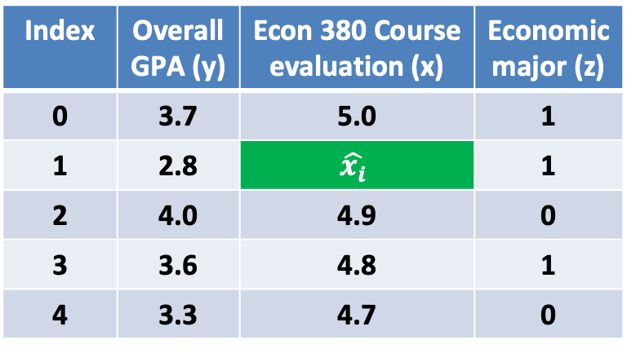
Imputation
Method 3: Heckman Selection Model
Index | Overall GPA (y) | Econ 380 Course evaluation (x) | Economic major (z)
0 | 3.7 | 5.0 | 1
1 | 2.8 | $$\hat{x_{i}}$$ | 1
2 | 4.0 | 4.9 | 0
3 | 3.6 | 4.8 | 1
4 | 3.3 | 4.7 | 0
If missing x (D)
0
1
0
0
0
Step 2. Outcome equation
Notes:
直觉上，λ相当于在控制"这个学生本身就是那种更愿意填评教的类型"这个未观测因素。如果 $β_{3}$显著不为0，说明"是否填写评教"这件事和"结果y（GPA）"之间存在没被x、z解释掉的相关性——也就是selection bias确实存在，Heckman模型把它显式地估计出来并从β₁、β₂中"剔除"了这部分偏差。

Slide 46
Variable Selection (Feature Engineering)

Slide 47
Outline
The role of domain knowledge
Skewed data: detection and fix
Convert categorical variables to numerical variable

Slide 48
The role of domain knowledge
Domain knowledge can help us understand how our data are collected and hence, the appropriate methods for preprocessing.
With domain knowledge, we will also have guidance on what features might be helpful to our model.

Slide 49
Skewed data
Why is it a concern?
Violate assumptions of some statistical models.
Put too much weight on the tail…
Explanatory model: may generate misleading results
Predictive model: low predictive power

Slide 50
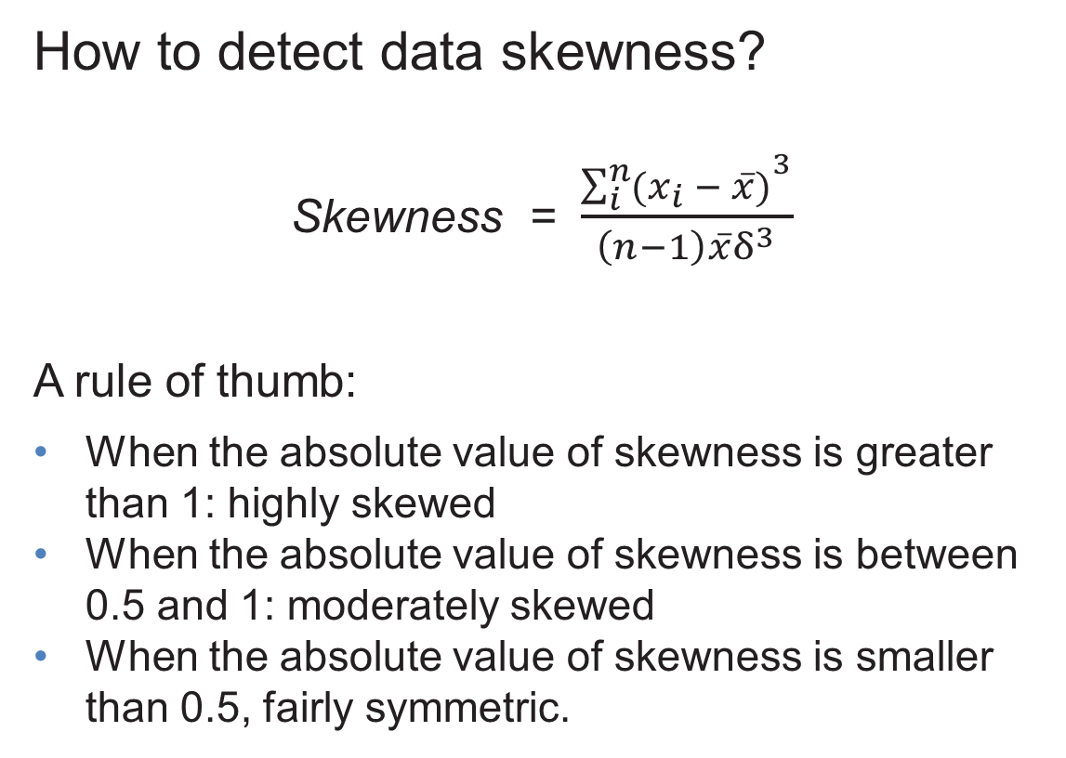
Skewed data
How to detect data skewness?
Skewness = $\frac{{\sum_{i}^{n}{(x_{i} − \overline{x})}}^{3}}{\left(n−1\right)\overline{x}δ^{3}}$
A rule of thumb:
When the absolute value of skewness is greater than 1: highly skewed
When the absolute value of skewness is between 0.5 and 1: moderately skewed
When the absolute value of skewness is smaller than 0.5, fairly symmetric.

Slide 51
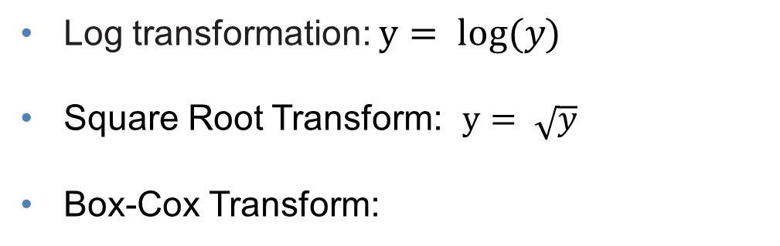

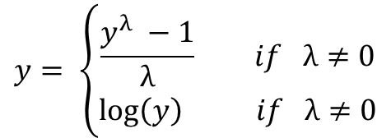
Skewed data
How to “fix” skewed data
Log transformation: $y= log⁡(y)$
Square Root Transform: $y= \sqrt{y}$
Box-Cox Transform:
$$y= \left\{\begin{aligned}\frac{y^{λ} −1}{λ} if λ≠0 \\ \log\left(y\right) if λ≠0\end{aligned}\right.$$
$$where −5< λ<5$$

Slide 52
Convert categorical variable to numerical variables
Categorical variables with ordinal relationship
Categorical variables without ordinal relationship
Notes:
Categorical Variables with Ordinal Relationship
Definition: These are variables where the categories have a meaningful order or ranking. However, the intervals between the categories are not necessarily equal or measurable.
Example:
Education level: High School < Bachelor’s < Master’s < Ph.D.
Customer satisfaction: Very Dissatisfied < Dissatisfied < Neutral < Satisfied < Very Satisfied.
Key Characteristics:
There is a clear progression or hierarchy between categories.
The difference between levels is not quantitatively precise (e.g., the jump from "Neutral" to "Satisfied" isn’t necessarily the same as from "Satisfied" to "Very Satisfied").
How to Interpret:
Focus on the ranking or order when analyzing, such as identifying trends or shifts in higher or lower categories.
Use appropriate statistical methods, such as ordinal regression or non-parametric tests like Spearman’s rank correlation, for analysis.
Categorical Variables Without Ordinal Relationship
Definition: These are variables where the categories do not have any inherent order or ranking.
Example:
Colors of a product: Red, Blue, Green.
Types of animals: Dog, Cat, Bird.
Countries: USA, Canada, Mexico.
Key Characteristics:
Categories are purely labels and are independent of each other.
No mathematical or logical progression exists between categories.
How to Interpret:
Emphasize group membership rather than order.
Analyze using frequency counts, proportions, or Chi-square tests to determine relationships or associations between variables.

Slide 53
Machine Learning Models
Part 1. Linear model with regularization

Slide 54
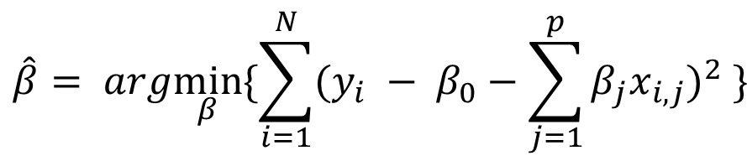
Linear Regression (LS)
$RSS= \sum_{i=1}^{N}{{(y_{i} − \hat{y})}^{2}= }$ $\sum_{i=1}^{N}{{(y_{i} − β_{0}−\sum_{j=1}^{p}{β_{j}x_{i,j}})}^{2} }$
$$\hat{β}= arg\min_{β}{\{\sum_{i=1}^{N}{{(y_{i} − β_{0}−\sum_{j=1}^{p}{β_{j}x_{i,j}})}^{2} }\}}$$

Slide 55
Linear Regression with Regularization
Regularization refers to techniques that are used to calibrate machine learning models in order to minimize the adjusted loss function and prevent overfitting or underfitting.
Commonly use techniques
Lasso (our focus)
Ridge
Elastic Net

Slide 56
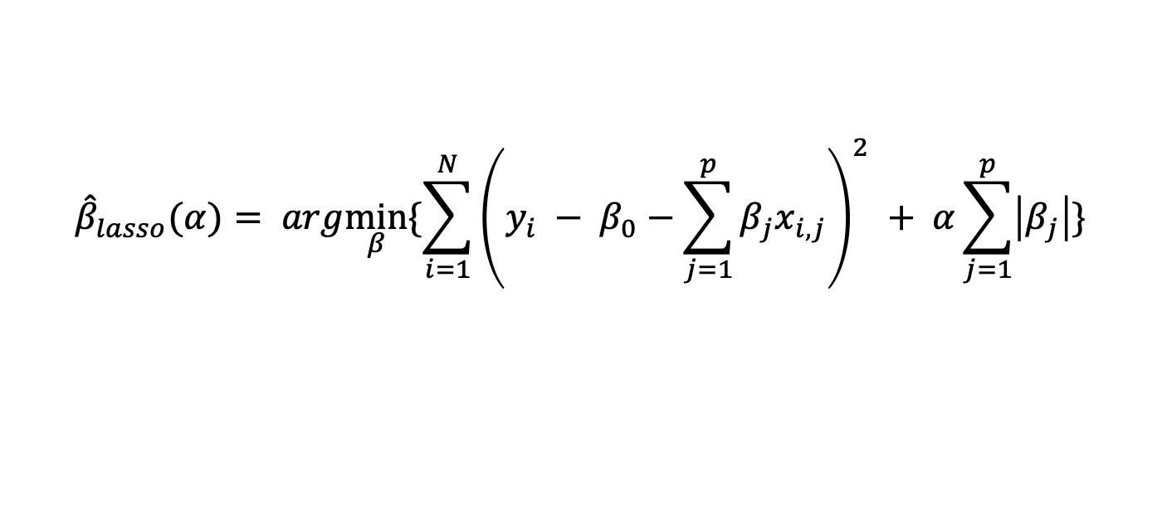
LASSO
LASSO refers to
Least Absolute Shrinkage and Selection Operator
$${\hat{β}}_{lasso}(α)= arg\min_{β}{\{\sum_{i=1}^{N}{{\left(y_{i} − β_{0}−\sum_{j=1}^{p}{β_{j}x_{i,j}}\right)}^{2} }+ α\sum_{j=1}^{p}{\left|β_{j}\right|}\}}$$
Intuitively, use a penalty term to control model complexity.

Slide 57
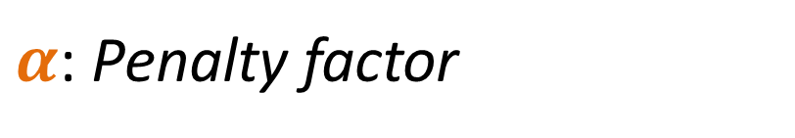
LASSO
LASSO refers to
Least Absolute Shrinkage and Selection Operator
$α$: Penalty factor
$When α=0:$ ${\hat{ β}}_{lasso}\left(α\right)={\hat{β}}_{ols}$
$When α→∞:$ ${\hat{ β}}_{lasso}\left(α\right)=0$
LASSO Shrink those not-that-important parameters to 0, and therefore, could be used for variable selection (use with caution).

Slide 58
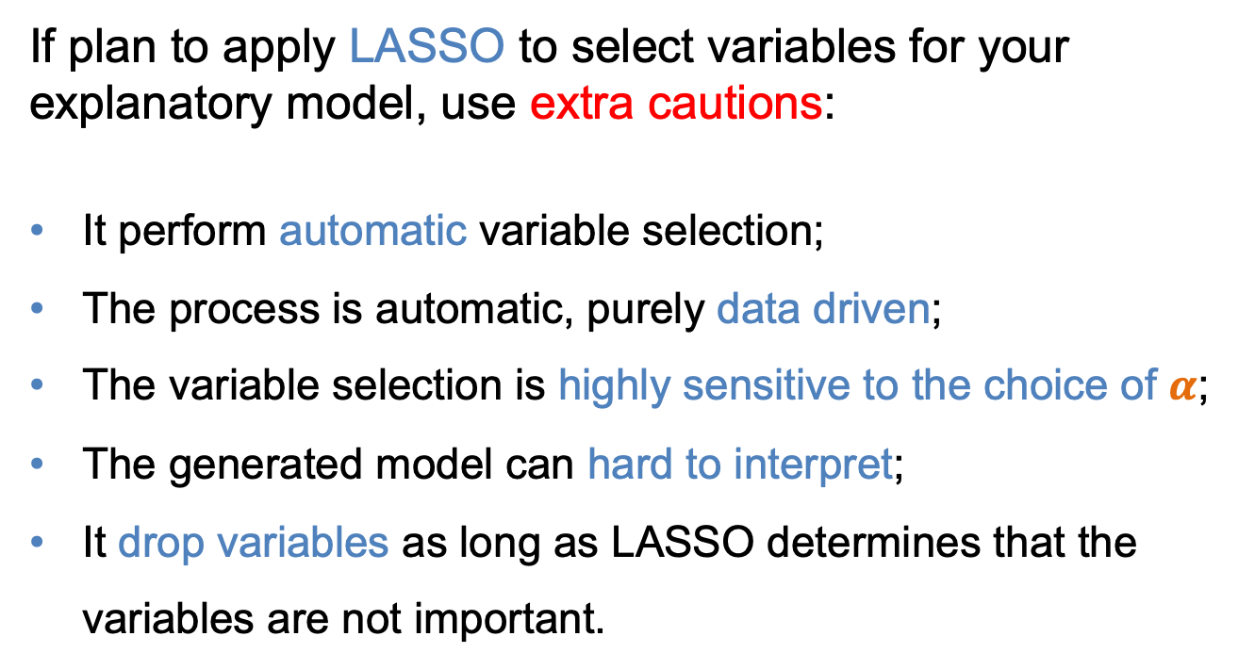
LASSO and Explanatory Model
If plan to apply LASSO to select variables for your explanatory model, use extra cautions:
It perform automatic variable selection;
The process is automatic, purely data driven;
The variable selection is highly sensitive to the choice of $α$;
The generated model can hard to interpret;
It drop variables as long as LASSO determines that the variables are not important.

Slide 59
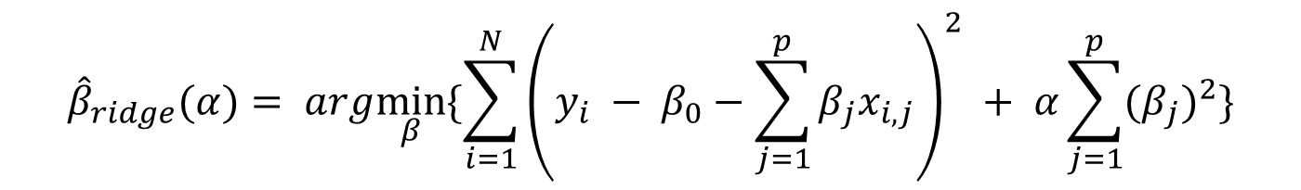
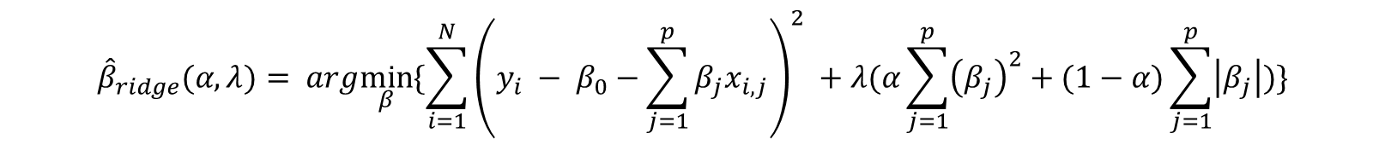
Other linear model with regularization
Ridge
$${\hat{β}}_{ridge}(α)= arg\min_{β}{\{\sum_{i=1}^{N}{{\left(y_{i} − β_{0}−\sum_{j=1}^{p}{β_{j}x_{i,j}}\right)}^{2} }+ α\sum_{j=1}^{p}{{(β_{j})}^{2}}\}}$$
Elastic Net
$${\hat{β}}_{ridge}(α, λ)= arg\min_{β}{\{\sum_{i=1}^{N}{{\left(y_{i} − β_{0}−\sum_{j=1}^{p}{β_{j}x_{i,j}}\right)}^{2} }+λ(α\sum_{j=1}^{p}{{\left(β_{j}\right)}^{2}}+(1−α)\sum_{j=1}^{p}{\left|β_{j}\right|)}\}}$$

Slide 60
Machine Learning Models
Part 2. Tree-based regression models

Slide 61
Tree-based models
Tree-based models use a series of if-then rules to generate predictions from one or more decision trees.
All tree-based models can be used for either regression or classification.
In this module, we will introduce three types of tree-based models:
Regression Tree
Random Forest
Gradient Boost

Slide 62
Decision Tree
A decision tree is a type supervised machine learning algorithm that makes predictions based on how a previous set of questions were answered.
Root node: The base of the decision tree.
Splitting: The process of dividing a node into multiple sub-nodes.
Decision node: a sub-node that is further split into additional sub-nodes.
Leaf node: a sub-node does not split further, represents possible outcomes.
Pruning: The process of removing sub-nodes of a decision tree.
Branch: A subsection of the decision tree consisting of multiple nodes.
determining which features to split on and then deciding when to stop splitting.

Slide 63
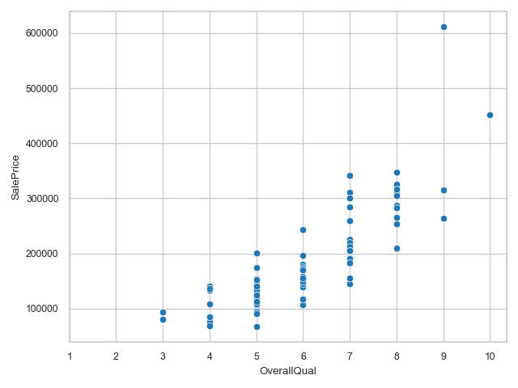
Decision Tree

Slide 64
Quality =< 3
No
Yes
Decision Tree
Quality >= 9
value: 87k
Let’s plant a tree!
Mean = $87,250

Slide 65
Quality < 3
No
Yes
Decision Tree
Quality >= 9
value: 87k
No
Yes
Quality >= 7
value: 425k
Mean = $424,523
Let’s plant a tree!

Slide 66
Quality < 3
No
Yes
Decision Tree
Quality >= 9
value: 87k
No
Yes
Quality >= 7
value: 425k
No
Yes
value: 255k
Quality >= 5
Mean = $255,176
Let’s plant a tree!

Slide 67
Quality < 3
No
Yes
Decision Tree
Quality >= 9
value: 87k
No
Yes
Quality >= 7
value: 425k
No
Yes
value: 255k
Quality >= 5
No
Yes
value: 142k
Quality = 4
Let’s plant a tree!
Mean = $141,902

Slide 68
Quality < 3
No
Yes
Decision Tree
Quality >= 9
value: 87k
No
Yes
Quality >= 7
value: 425k
No
Yes
value: 255k
Quality >= 5
No
Yes
value: 142k
Quality = 4
Yes
value: 110k
Let’s plant a tree!
Mean = $110, 470

Slide 69
Quality < 3
No
Yes
Decision Tree
Quality >= 9
value: 87k
No
Yes
Quality >= 7
value: 425k
No
Yes
value: 255k
Quality >= 5
No
Yes
value: 142k
Quality = 4
Yes
value: 110k
Let’s plant a tree!

Slide 70
Decision Tree
Two essential things in decision tree
determining which features to split on
deciding when to stop splitting
Hyperparameter tuning
Hyperparameters contain the data that govern the training process itself.
Hyperparameters in decision tree regressor:
criterion, splitter, max_depth, min_samples_split, min_samples_leaf, max_features, ……

Slide 71
Overfitting
Overfitting refers to a model that fits the training data too well…
Overfitting happens when a model learns the detail and noise in the training data to the extent that it negatively impacts the performance of the model on new data.

Slide 72
Random Forest
Random forest is a supervised learning algorithm.
The "forest" it builds, is an ensemble of decision trees trained with the “bootstrap” method.
The intuition behind the random forest is that a combination of learning models increases the overall result.

Slide 73
Random Forest
1. Create a bootstrapped dataset

Slide 74
Random Forest
Original Dataset
Bootstrapped Dataset
 | House age | Overall quality | Total sqft
Obs. 1 | 50 | 5 | 2000
Obs. 2 | 10 | 2 | 5000
Obs. 3 | 30 | 3 | 2500
Obs. 4 | 3 | 10 | 900
Obs. 5 | 10 | 6 | 3000
 | House age | Overall quality | Total sqft

Slide 75
Random Forest
Original Dataset
Bootstrapped Dataset
 | House age | Overall quality | Total sqft
Obs. 1 | 50 | 5 | 2000
Obs. 2 | 10 | 2 | 5000
Obs. 3 | 30 | 3 | 2500
Obs. 4 | 3 | 10 | 900
Obs. 5 | 10 | 6 | 3000
 | House age | Overall quality | Total sqft
Obs. 1 | 50 | 5 | 2000

Slide 76
Random Forest
Original Dataset
Bootstrapped Dataset
 | House age | Overall quality | Total sqft
Obs. 1 | 50 | 5 | 2000
Obs. 2 | 10 | 2 | 5000
Obs. 3 | 30 | 3 | 2500
Obs. 4 | 3 | 10 | 900
Obs. 5 | 10 | 6 | 3000
 | House age | Overall quality | Total sqft
1 | 50 | 5 | 2000
2 | 30 | 3 | 2500

Slide 77
Random Forest
Original Dataset
Bootstrapped Dataset
 | House age | Overall quality | Total sqft
Obs. 1 | 50 | 5 | 2000
Obs. 2 | 10 | 2 | 5000
Obs. 3 | 30 | 3 | 2500
Obs. 4 | 3 | 10 | 900
Obs. 5 | 10 | 6 | 3000
 | House age | Overall quality | Total sqft
1 | 50 | 5 | 2000
2 | 30 | 3 | 2500
3 | 50 | 5 | 2000

Slide 78
Random Forest
Original Dataset
Bootstrapped Dataset
 | House age | Overall quality | Total sqft
Obs. 1 | 50 | 5 | 2000
Obs. 2 | 10 | 2 | 5000
Obs. 3 | 30 | 3 | 2500
Obs. 4 | 3 | 10 | 900
Obs. 5 | 10 | 6 | 3000
 | House age | Overall quality | Total sqft
1 | 50 | 5 | 2000
2 | 30 | 3 | 2500
3 | 50 | 5 | 2000
4 | 3 | 10 | 900

Slide 79
Random Forest
Original Dataset
Bootstrapped Dataset
 | House age | Overall quality | Total sqft
Obs. 1 | 50 | 5 | 2000
Obs. 2 | 10 | 2 | 5000
Obs. 3 | 30 | 3 | 2500
Obs. 4 | 3 | 10 | 900
Obs. 5 | 10 | 6 | 3000
 | House Age | Overall quality | Total sqft
1 | 50 | 5 | 2000
2 | 30 | 3 | 2500
3 | 50 | 5 | 2000
4 | 3 | 10 | 900
5 | 10 | 2 | 5000

Slide 80
Random Forest
Create a bootstrapped dataset
Create a decision tree using the bootstrapped dataset, but only use a random subset of variables at each step.

Slide 81
Random Forest
Bootstrapped Dataset
Overall
Quality
 | House Age | Overall quality | Total sqft
1 | 50 | 5 | 2000
2 | 30 | 3 | 2500
3 | 50 | 5 | 2000
4 | 3 | 10 | 900
5 | 10 | 2 | 5000
Total sqft
house
age
only use a random subset of variables at each step

Slide 82


Slide 83
Random Forest
Create a bootstrapped dataset
Create a decision tree using the bootstrapped dataset, but only use a random subset of variables at each step.
Repeat step 1 and step 2 "many" times.

Slide 84

Random Forest

Slide 85
Random Forest
Create a bootstrapped dataset
Create a decision tree using the bootstrapped dataset, but only use a random subset of variables at each step.
Repeat step 1 and step 2 many times.
Running through all the trees in the forest, and use the aggregated result to make a decision.

Slide 86
Random Forest
 | Overall Quality | House age | Total sqrt
New Data | 7 | 15 | 2000
 | Predicted Housing Price
Tree 1 | 250K
Tree 2 | 220K
Tree 3 | 235K
Tree 4 | 270K
... | ...
Tree N | 210K
aggregating information
236 K

Slide 87
Random Forest
Bootstrapping the data +
aggregate information to make a decision
=
Bagging

Slide 88
Gradient Boost
Gradient boost model is a stage-wise additive model that generates “learners” during the model training process (i.e., trees are added one at a time, and existing trees in the model are not changed).
The contribution of the new learner to the ensemble is based on the gradient descent optimization process. The calculated contribution of each tree is based on minimizing the overall error.
Intuition: take a small step toward the right direction every time

Slide 89
Gradient Boost
House age | Overall Quality | Total Sqrt | Sale Price | Pseudo Residual
30 | 3 | 2500 | 80k | -101k
3 | 10 | 900 | 350k | 169k
10 | 6 | 3000 | 440k | 259k
… | … | … | … | …
12 | 9 | 3000 | 520k | 339k
21 | 5 | 2100 | 100k | -81k
Notes:
1. The number of leaves: the more, the easier to get overfitting result. In this example, we use 4. In practice, it is common to select a much larger number such as 8 or even 32.

Slide 90

Gradient Boost
House age | Overall Quality | Total Sqrt | Sale Price
30 | 3 | 2500 | 80k
3 | 10 | 900 | 350k
10 | 6 | 3000 | 440k
… | … | … | …
12 | 9 | 3000 | 520k
21 | 5 | 2100 | 100k
Pseudo Residual
-101k
169k
259k
…
339k
-81k
Quality<8
age > 20 sqrt<2k
-101, -81
259
169 339
-91
Step 3: use selected features to build a tree to predict the Pseudo Residual
Step 1: initial guess: average Sale Price
Avg. Sale Price = (80 + 350 + 440 + …+ 520)/n
= 181k
Step 2: calculate Pseudo residual
e.g. 80k – 181k = -101k, 350k-181k = 169k, etc.
Notes:
1. The number of leaves: the more, the easier to get overfitting result. In this example, we use 4. In practice, it is common to select a much larger number such as 8 or even 32.

Slide 91
Gradient Boost
House age | Overall Quality | Total Sqrt | Sale Price
30 | 3 | 2500 | 80k
3 | 10 | 900 | 350k
10 | 6 | 3000 | 440k
… | … | … | …
12 | 9 | 3000 | 520k
21 | 5 | 2100 | 100k
Pseudo Residual
-101k
169k
259k
…
339k
-81k
Quality<8
age > 20 sqrt<2k
-101, -81
259
169 339
-91
Step 3: use selected features to build a tree to predict the Pseudo Residual
Step 4: combine the initial guess and the tree to make a new prediction
prediction
181 – 91 = 90k
181 + 169= 350k
181 + 259 = 440k
…
181 + 339 = 520k
181 – 91 = 90k
Avg. Sale Price = (80 + 350 + 440 + …+ 520)/n
= 181k
+ =
Notes:
1. The number of leaves: the more, the easier to get overfitting result. In this example, we use 4. In practice, it is common to select a much larger number such as 8 or even 32.

Slide 92
Gradient Boost
House age | Overall Quality | Total Sqrt | Sale Price
30 | 3 | 2500 | 80k
3 | 10 | 900 | 350k
10 | 6 | 3000 | 440k
… | … | … | …
12 | 9 | 3000 | 520k
21 | 5 | 2100 | 100k
Pseudo Residual
-101k
169k
259k
…
339k
-81k
Easy to overfit!
Step 4: combine the initial guess and the tree to make a new prediction
prediction
181 – 91 = 90k
181 + 169= 350k
181 + 259 = 440k
…
181 + 339 = 520k
181 – 91 = 90k
Avg. Sale Price = (80 + 350 + 440 + …+ 520)/n
= 181k
Quality<8
+ =
age > 20 sqrt<2k
-101, -81
259
169 339
-91
Notes:
1. The number of leaves: the more, the easier to get overfitting result. In this example, we use 4. In practice, it is common to select a much larger number such as 8 or even 32.

Slide 93
Gradient Boost
House age | Overall Quality | Total Sqrt | Sale Price
30 | 3 | 2500 | 80k
3 | 10 | 900 | 350k
10 | 6 | 3000 | 440k
… | … | … | …
12 | 9 | 3000 | 520k
21 | 5 | 2100 | 100k
Pseudo Residual
-101k
169k
259k
…
339k
-81k
Easy to overfit!
Step 4: combine the initial guess and the tree to make a new prediction
prediction
181 – 91 = 90k
181 + 169= 350k
181 + 259 = 440k
…
181 + 339 = 520k
181 – 91 = 90k
Avg. Sale Price = (80 + 350 + 440 + …+ 520)/n
= 181k
Quality<8
Learning Rate
+ x =
age > 20 sqrt<2k
-101, -81
259
169 339
-91
Notes:
1. The number of leaves: the more, the easier to get overfitting result. In this example, we use 4. In practice, it is common to select a much larger number such as 8 or even 32.

Slide 94
Gradient Boost
House age | Overall Quality | Total Sqrt | Sale Price
30 | 3 | 2500 | 80k
3 | 10 | 900 | 350k
10 | 6 | 3000 | 440k
… | … | … | …
12 | 9 | 3000 | 520k
21 | 5 | 2100 | 100k
Pseudo Residual
-101k
169k
259k
…
339k
-81k
Don’t learn too much from one tree ...
Step 4: combine the initial guess and the tree to make a new prediction
prediction
181 – 91 x 0.1 = 171.9k
181 + 169 x 0.1 = 197.9k
181 + 259 x 0.1 = 206.9k
…
181 + 339 x 0.1 = 214.9k
181 – 81 x 0.1 = 172.9k
Avg. Sale Price = (80 + 350 + 440 + …+ 520)/n
= 181k
Quality<8
+ x =
0.1
age > 20 sqrt<2k
-101, -81
259
169 339
-91
Notes:
1. The number of leaves: the more, the easier to get overfitting result. In this example, we use 4. In practice, it is common to select a much larger number such as 8 or even 32.

Slide 95
Gradient Boost
House age | Overall Quality | Total Sqrt | Sale Price
30 | 3 | 2500 | 80k
3 | 10 | 900 | 350k
10 | 6 | 3000 | 440k
… | … | … | …
12 | 9 | 3000 | 520k
21 | 5 | 2100 | 100k
Pseudo Residual
-101k
169k
259k
…
339k
-81k
New Residual
-91.9k
152.1k
233.1k
…
305.1k
-91.9k
Step 5: use the new prediction to calculate the New Residual
Step 4: combine the initial guess and the tree to make a new prediction
prediction
181 – 91 x 0.1 = 171.9k
181 + 169 x 0.1 = 197.9k
181 + 259 x 0.1 = 206.9k
…
181 + 339 x 0.1 = 214.9k
181 – 81 x 0.1 = 172.9k
Avg. Sale Price = (80 + 350 + 440 + …+ 520)/n
= 181k
Quality<8
+ x =
0.1
age > 20 sqrt<2k
-101, -81
259
169 339
-91
Notes:
1. The number of leaves: the more, the easier to get overfitting result. In this example, we use 4. In practice, it is common to select a much larger number such as 8 or even 32.

Slide 96
Gradient Boost
House age | Overall Quality | Total Sqrt | Sale Price
30 | 3 | 2500 | 80k
3 | 10 | 900 | 350k
10 | 6 | 3000 | 440k
… | … | … | …
12 | 9 | 3000 | 520k
21 | 5 | 2100 | 100k
Pseudo Residual
-101k
169k
259k
…
339k
-81k
New Residual
-91.9k
152.1k
233.1k
…
305.1k
-91.9k
Step 6: use selected features to build a tree to predict the New Residual
prediction
181 – 91 x 0.1 = 171.9k
181 + 169 x 0.1 = 197.9k
181 + 259 x 0.1 = 206.9k
…
181 + 339 x 0.1 = 214.9k
181 – 81 x 0.1 = 172.9k
Avg. Sale Price = (80 + 350 + 440 + …+ 520)/n
= 181k
Quality<8
+ x =
0.1
age > 20 sqrt<2k
-101, -81
259
169 339
-91
Notes:
1. The number of leaves: the more, the easier to get overfitting result. In this example, we use 4. In practice, it is common to select a much larger number such as 8 or even 32.

Slide 97
Gradient Boost
House age | Overall Quality | Total Sqrt | Sale Price
30 | 3 | 2500 | 80k
3 | 10 | 900 | 350k
10 | 6 | 3000 | 440k
… | … | … | …
12 | 9 | 3000 | 520k
21 | 5 | 2100 | 100k
Pseudo Residual
-101k
169k
259k
…
339k
-81k
New Residual
-91.9k
152.1k
233.1k
…
305.1k
-91.9k
Step 6: use selected features to build a tree to predict the New Residual
Step 7: add the second tree to the existing one, make a new prediction
prediction
181 – 91 x 0.1 = 171.9k
181 + 169 x 0.1 = 197.9k
181 + 259 x 0.1 = 206.9k
…
181 + 339 x 0.1 = 214.9k
181 – 81 x 0.1 = 172.9k
Avg. Sale Price = (80 + 350 + 440 + …+ 520)/n
= 181k
Quality<8
+ X 0.1
+ x
0.1
age > 20 sqrt<2k
-101, -81
259
169 339
-91
Notes:
1. The number of leaves: the more, the easier to get overfitting result. In this example, we use 4. In practice, it is common to select a much larger number such as 8 or even 32.

Slide 98
Gradient Boost
Step 8: replicate the above until adding more trees won’t reduce the residual significantly
Quality<8
X 0.1
+
+
181k
X 0.1
age > 20 sqrt<2k
-191
259
169 339
+
+
X 0.1
X 0.1
+
+
+ ……
X 0.1
X 0.1

Slide 99
Machine Learning Models
Part 3. Cross Validation and Grid Search

Slide 100
Cross Validation
Cross validation: use different parts of the data to "test" the model, and then summarize the result.
One of the most common types of cross validation is k-fold cross validation, where ‘k’ is the number of folds within the dataset.

Slide 101
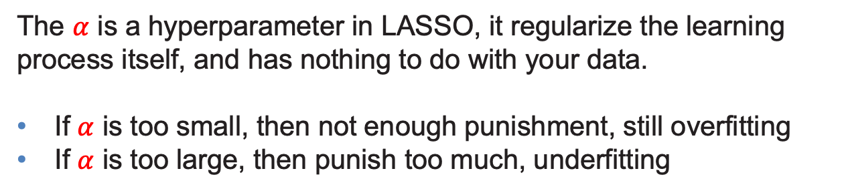
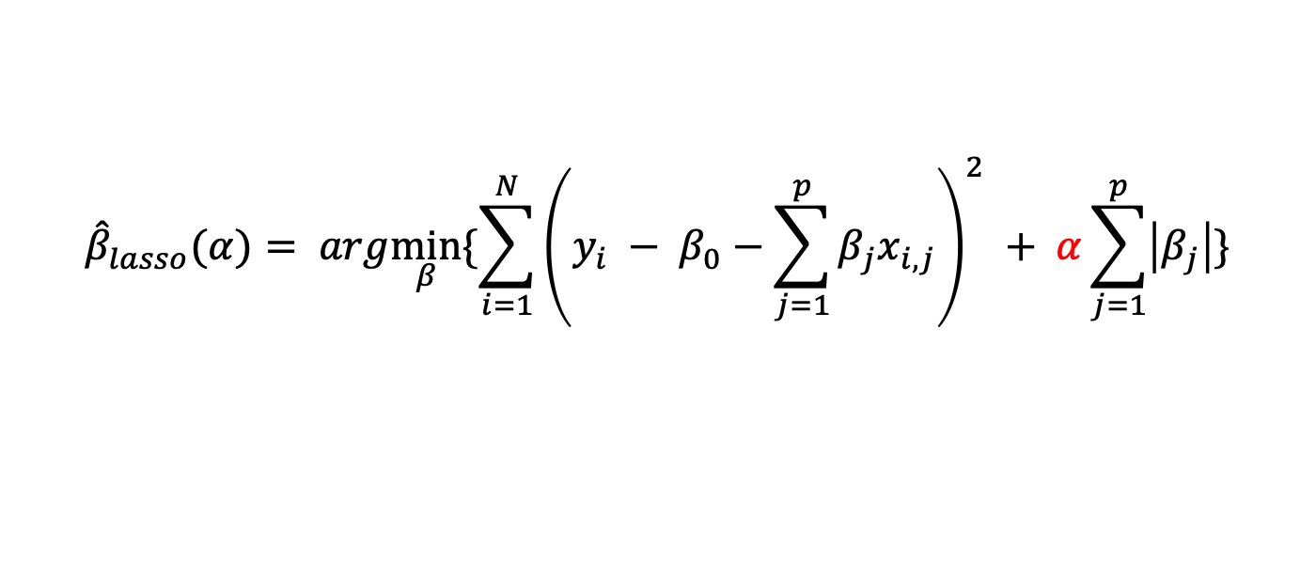
Cross Validation
Example: choosing the penalty factor in LASSO
$${\hat{β}}_{lasso}(α)= arg\min_{β}{\{\sum_{i=1}^{N}{{\left(y_{i} − β_{0}−\sum_{j=1}^{p}{β_{j}x_{i,j}}\right)}^{2} }+ α\sum_{j=1}^{p}{\left|β_{j}\right|}\}}$$
The $α$ is a hyperparameter in LASSO, it regularize the learning process itself, and has nothing to do with your data.
If $α$ is too small, then not enough punishment, still overfitting
If $α$ is too large, then punish too much, underfitting

Slide 102
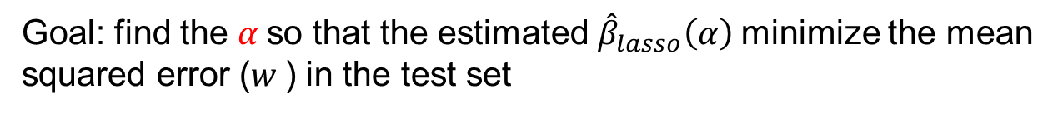
Cross Validation
Example: choosing the penalty factor in LASSO
$${\hat{β}}_{lasso}(α)= arg\min_{β}{\{\sum_{i=1}^{N}{{\left(y_{i} − β_{0}−\sum_{j=1}^{p}{β_{j}x_{i,j}}\right)}^{2} }+ α\sum_{j=1}^{p}{\left|β_{j}\right|}\}}$$
Goal: find the $α$so that the estimated ${\hat{β}}_{lasso}\left(α\right)$minimize the mean squared error ($w$) in the test set

Slide 103
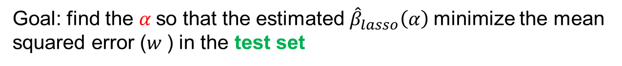
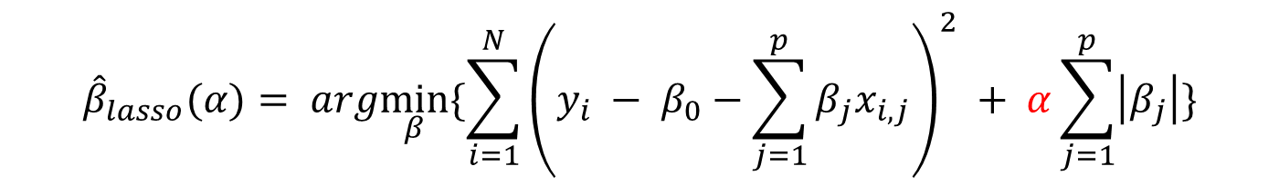
Split the Dataset
Example: choosing the penalty factor in LASSO
Train Set | Validation | Test Set
Train Set | Test Set
$${\hat{β}}_{lasso}(α)= arg\min_{β}{\{\sum_{i=1}^{N}{{\left(y_{i} − β_{0}−\sum_{j=1}^{p}{β_{j}x_{i,j}}\right)}^{2} }+ α\sum_{j=1}^{p}{\left|β_{j}\right|}\}}$$
Goal: find the $α$so that the estimated ${\hat{β}}_{lasso}\left(α\right)$minimize the mean squared error ($w$) in the test set
$$α:\left[0.1, 0.3, 1\right], which one is the best?$$
Notes:
Why not just try different alpha on the test set (repeat) and select the best?
You can, but not recommended. Information leak!
You don’t want to give the model a chance to “see” the test set, otherwise the model will be biased toward that particular test set.

Slide 104
Cross Validation
Train Set | Validation | Test Set

Slide 105
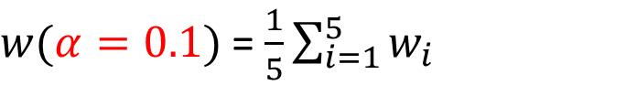





K-fold Cross Validation
Train Set | Validation
Iteration 1: $msw=w_{1}$
 |  |  | Validation
Iteration 2: $msw=w_{2}$
 |  | Validation
Iteration 3: $msw=w_{3}$
 | Validation
Iteration 4: $msw=w_{4}$
Validation
Iteration 5: $msw=w_{5}$
$w(α=0.1)$ = $\frac{1}{5}\sum_{i=1}^{5}{w_{i}}$
Notes:
In the end, all block of data is used for validation, so the result is not biased toward any particular validation set.
This is a good way to evaluate your model performance
This method is known as k-fold cross validation

Slide 106
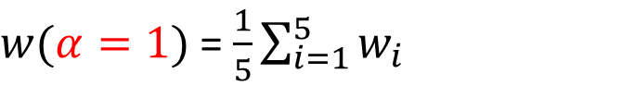
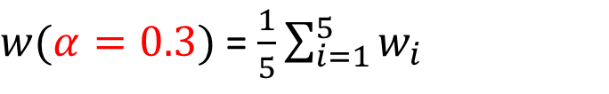
Cross Validation + Grid Search
Replicate this process for $α=0.3 and α=1$
$w(α=0.3)$ = $\frac{1}{5}\sum_{i=1}^{5}{w_{i}}$
$w(α=1)$ = $\frac{1}{5}\sum_{i=1}^{5}{w_{i}}$
And then pick the that gives the smallest $w$
$w(α=0.1)$ = $\frac{1}{5}\sum_{i=1}^{5}{w_{i}}$

Slide 107
Hyperparameter tuning techniques
Grid search
Random search
Bayesian optimization
Tree-structured Parzen estimators (TPE)

Slide 108
Machine Learning Models
Part 3. Classification

Slide 109
Classification

Slide 110
Classification
Classification
Linear regression
Supervised Learning
Linear regression with regularization
Regression
Decision tree
Gradient boost
Random forest

Slide 111
Classification algorithm
Classification algorithms
Logistic regression
Tree-based model
K-nearest neighbors
Naïve Bayes
Support Vector Machine(SVM)
Model evaluation
The confusion matrix and related metrics

Slide 112
Model evaluation
Classification algorithms
Logistic regression
Tree-based model
Naïve Bayes
K-nearest neighbors
Support Vector Machine(SVM)
Model performance evaluation
The confusion matrix and related metrics

Slide 113
Classification algorithm
Model performance evaluation
The confusion matrix and related metrics
Example: mortgage default
Imagine we built a model that can help to predict if a homeowner fails to uphold the agreed-upon terms defined in their promissory note or deed of trust they signed when taking out their mortgage (i.e., default).

Slide 114
Confusion Matrix
Clearly define “positive” and “negative”
Positive: defaulting
Negative: not defaulting.
 |  | Prediction
 |  | Default | Normal
Observation | Default | True Positive | False Negative
 | Normal | False Positive | True Negative

Slide 115
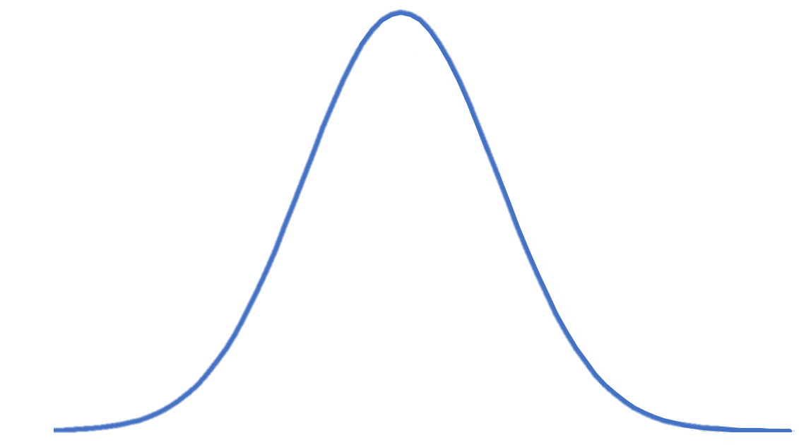
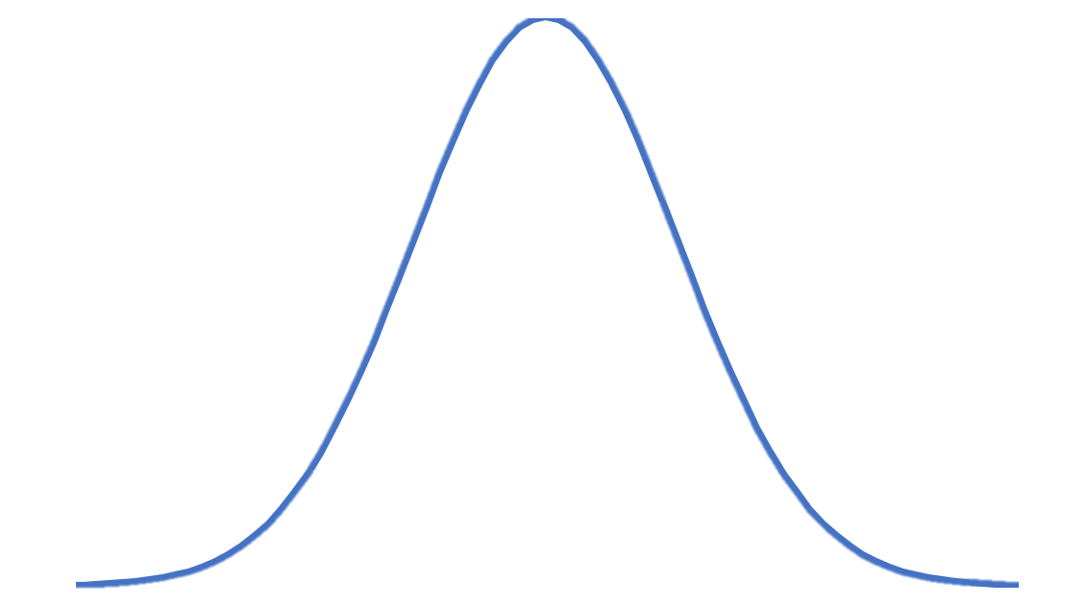


Confusion Matrix
Type I and Type II errors
Suppose the null hypothesis is the customer will not default (i.e., normal account)
Type I error: identify mortgage default while account is normal (reject null while it is true: false positive).
Type II error: identify normal for mortgage default cases
(accept null while it is not true: false negative).
(H0)Distribution
(H1)Distribution
$$β$$
$$α$$

Slide 116




Confusion Matrix
In machine learning, what metrics shall be used to evaluate model performance?
Sensitivity (aka, recall, hit rate, or true positive rate)
$$\frac{TP}{TP+FN}$$
Specificity (aka, selectivity, or true negative rate)
$$\frac{TN}{TN+FP}$$
Precision (aka, positive predictive rate)
$$\frac{TP}{TP+FP}$$
Negative predictive value
$$\frac{TN}{TN+FN}$$

Slide 117


Confusion Matrix
In machine learning, what metrics shall be used to evaluate model performance?
Accuracy (aka, positive predictive rate)
$$\frac{TP+TN}{TP+TN+FP+FN}$$
(i.e., a combination of sensitivity and specificity)
F1 score
$$\frac{2TP}{2TP+FP+FN}$$
(i.e., a combination of precision and sensitivity)

Slide 118
Confusion Matrix
In machine learning, what metrics shall be used to evaluate model performance?
The answer depends on your goal…
Example: predict possible default account
In the training data, 98.2% normal account, 1.8% default account
If I predict all observations as normal, what is the accuracy?
98.2%... a pretty good yet useless result
Instead of looking for maximum accuracy, F1 score is a better metrics in this case, as F1 score emphasize more on false negative and false positive

